Slide 1
Network Architecture, Protocol, and Transmission Media

Slide 2
Introduction to Computer Networks
Network Architecture
Network Protocols
Network Channels (Media)
Physical Transmission Media
Wireless Transmission Media
Wireless Transmission Devices

Slide 3
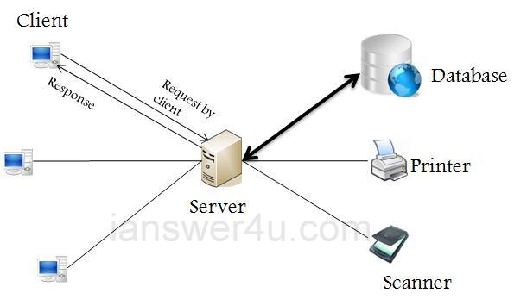
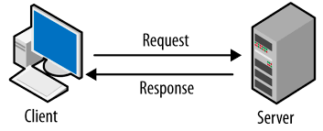
Network Architecture
Refers to how the computer or devices are designed in a network
Basic types:
Client/Server:
All clients must request service from the server
The server is also called a host
Node is any network device
Nodes are called clients

Slide 4
Network Architecture
Client/Server Network
Servers are used to control access
Users gain access by logging in
Database software
Access to data controlled by server
Server is the most important computer
Different servers perform different tasks: File server, network server, etc.
A file server specifically manages and shares files within a network, while a network server encompasses a broader range of services beyond file storage, such as email, web hosting, and database management.

Slide 5
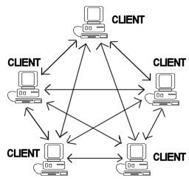
Network Architecture
Peer to Peer Networks (P2PN)
All nodes are equal
Nodes access resources on other nodes
Each node controls its own resources
Most modern OS allow P2PN
Good for small businesses and home networks
Simple and inexpensive

Slide 6
Network Protocols
Protocol
A set of rules that defines how data is formatted and processed on a network
Integration of three basic functions:
What is communicated?
How is it communicated?
When is it communicated?
Language of the network
Rules of communication
Error control
Size of packet

Slide 7
Network Protocols
Hypertext Transfer Protocol (HTTP): A client/server application that uses TCP for transport to retrieve HTML pages.
Domain Name Service (DNS): A name-to-address translation application that uses both TCP and UDP transport.
File Transport Protocol (FTP): A file transfer application that uses TCP for transport.
Network Time Protocol (NTP): An application that synchronizes time with a time source and uses UDP for transport.
Synchronize the clocks of computers and other network devices over a network, ensuring accurate timekeeping for activities such as logging and authentication.

Slide 8
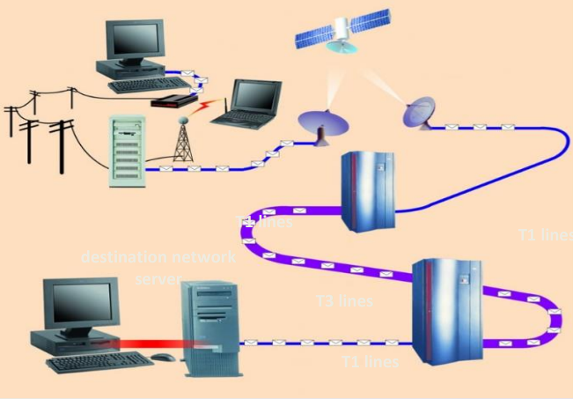
Network Channels (Media)
A channel is a path between two communication devices
Channel capacity: How much data can be passed through the channel (bit/sec)
Also called channel bandwidth
Consists of one or more transmission media
Two types:
Physical: wire cable
Wireless: Air

Slide 9
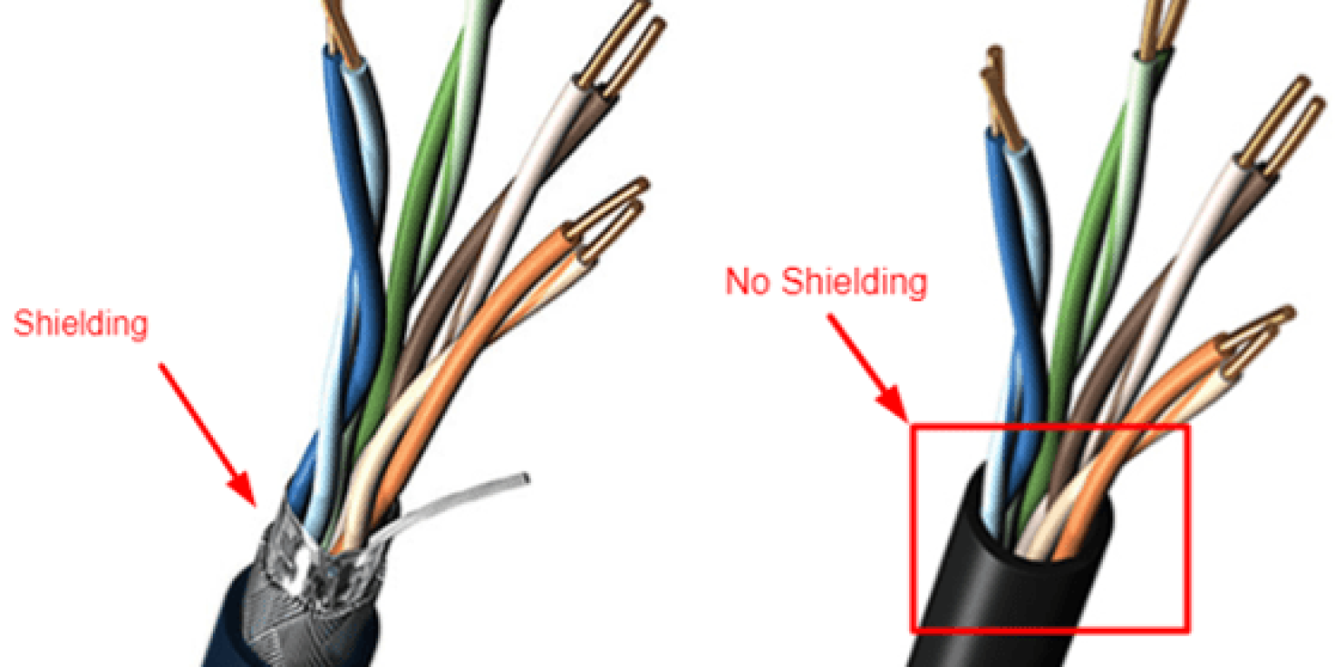
Physical Transmission Media
Twisted-pair cabling (Ethernet Cable)
Most common LAN cable
Called Cat5, Cat6
Four pairs of copper cable twisted
Speeds range from 1 Mbps to 1,000 Mbps

Slide 10
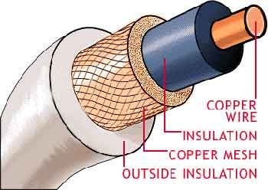
Physical Transmission Media
Coaxial cable
Similar to cable TV wire
central conductor surrounded by insulation
Speeds up to 10 Mbps

Slide 11
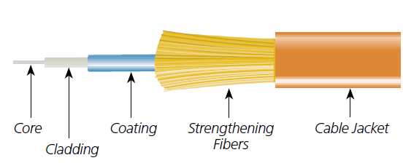
Physical Transmission Media
Fiber-optic cable
Data is transmitted with light pulses
Glass strand instead of cable
Speeds up to 100 Gbps

Slide 12
Wireless Transmission Media
Broadcast Radio
Medium that distributes radio signals through the air.
Uses an antenna, can be short range
Bluetooth is a kind of short-range (about 10 meters) broadcast radio communications
Cellular Radio
A form of broadcast radio used for mobile communication
High frequency radio waves to transmit voice or data
Difference: Broadcast radio sends content over a wide area for anyone to receive, while cellular radio enables mobile communication through a network of cells, managing individual connections dynamically.

Slide 13
Wireless Transmission Media
Microwaves
Radio waves providing high speed transmission
Microwaves must transmit in a straight line with no barrier between microwave antennas
Used for satellite communication
Infrared (IR)
Wireless transmission media that sends signals using infrared light-waves
IR transmission also requires a line-of-sight transmission as that required by microwaves
Infrared waves have shorter wavelengths and lower frequencies than radio waves.

Slide 14
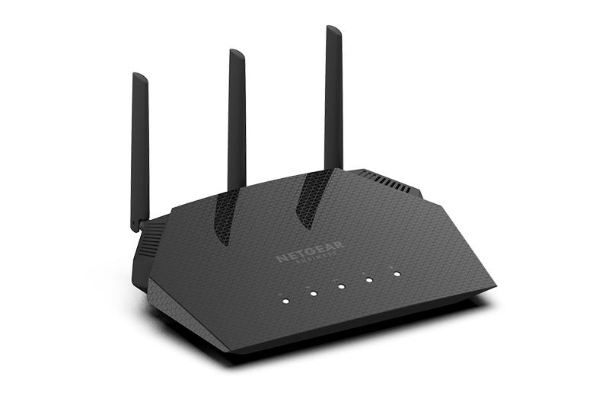
Wireless Transmission Devices
Wireless Access Point
Center of a wireless network
WAPs combined cover a larger area
Range is 50 to 150 meters

Slide 15
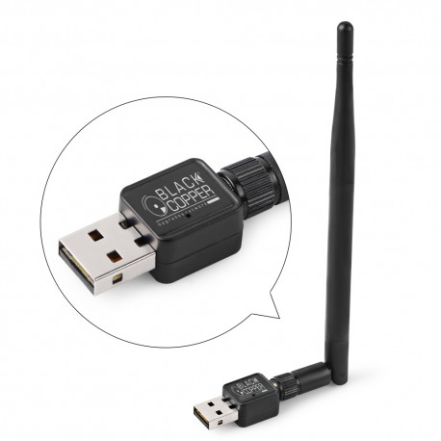
Wireless Transmission Devices
Wireless Adapters
Wireless adapters are hardware devices that enable computers to connect to wireless networks by transmitting and receiving wireless signals.

